Slide 1
AeroStat: Online Platform for the Statistical Intercomparison of Aerosols
Advancing Collaborative Connections for Earth System Science (ACCESS) Program
http://giovanni.gsfc.nasa.gov/aerostat/
Gregory Leptoukh, NASA/GSFC (P.I.)
Chris Lynnes, NASA/GSFC (Acting P.I.)
Peter Fox, RPI (Co-I.)
Jennifer Wei, Adnet/GSFC (Project Lead)
M. Hegde, Adnet/GSFC (Software Lead)
Robert Levy, SSAI/GSFC (Co-I.)
David Lary, U. of Texas at Dallas (Co-I.)
Ralph Kahn, NASA/GSFC (Collaborator)
Lorraine Remer, NASA/GSFC (Collaborator)
Charles Ichoku (Collaborator)
Contributions from
S. Ahmad, R. Albayrak, K. Bryant, D. da Silva, J. Amrhein, F. Fang, X. Hu, N. Malakar, M. Petrenko, L. Petrov, C. Smit

Slide 2
Outline
Why AeroStat?
Aerostat Features
DEMO
AeroStat Under the Hood
Achievements / Results
Going Forward

Slide 3
Why AeroStat?

Slide 4
Motive #1: Differences among aerosol measurements
Different instruments and algorithms have different measurement characteristics
Spatial coverage
Spatial consistency
Temporal consistency
Diurnal coverage
Vertical sensitivity
Sensitivity to sunglint, clouds, surface reflectance, aerosol types, ...

Slide 5
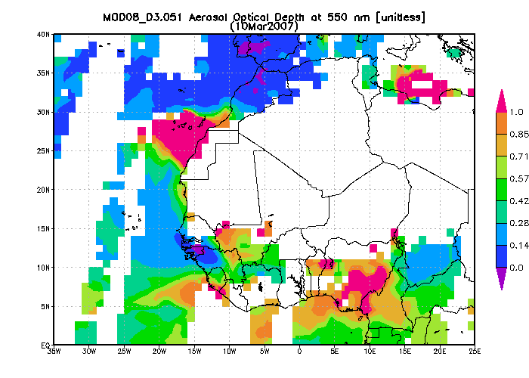
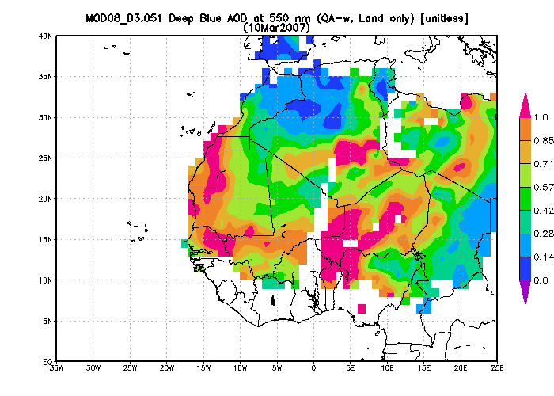
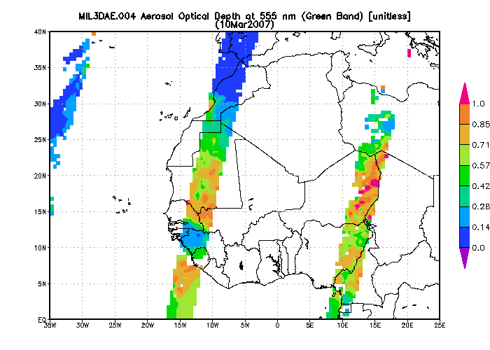
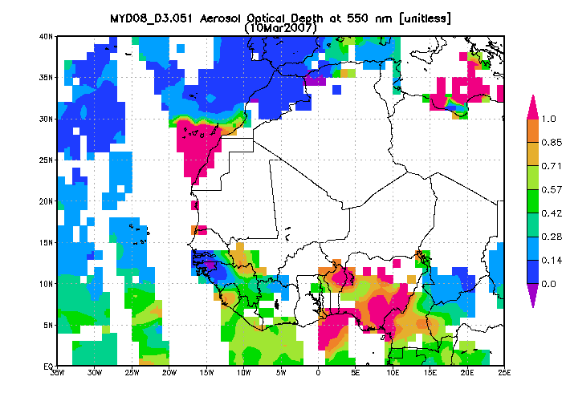
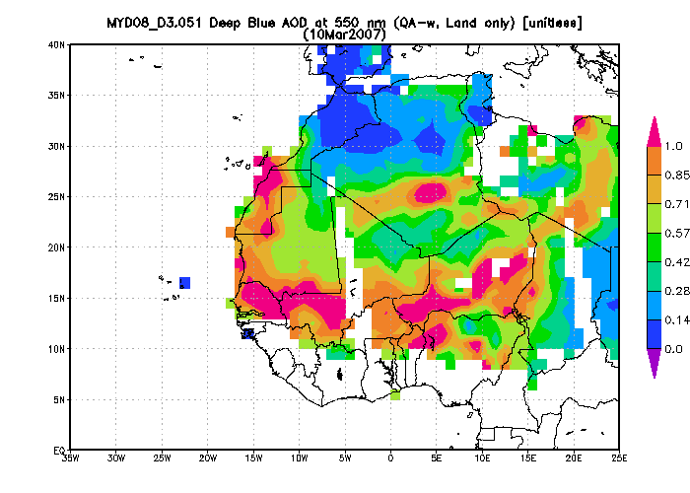
Motive #2: For phenomena such as dust transport, getting a full picture is challenging

Slide 6
Aerostat Features

Slide 7
Aerostat is an environment for aerosol comparison and collocation with supporting documentation
Essential documentation: Read Me First, quality statements, disclaimers, processing documentation, lineage...
Compare satellite w/ground-based aerosol measurements
Scatterplot
Time Series
Explore aerosol phenomena by merging multi-sensor data
Experiment with quality filter settings and bias adjustment
Save and share findings (and questions)

Slide 8
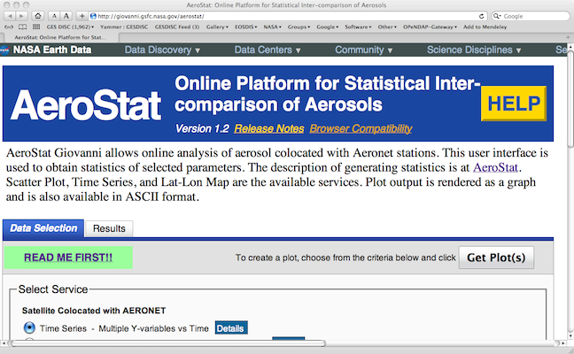
Essential documentation

Slide 9
DEMO
http://giovanni.gsfc.nasa.gov/aerostat/
(Please, try it out, it’s operational.)

Slide 10
AeroStat Under the Hood

Slide 11
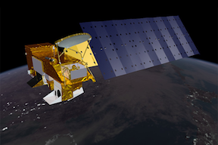
Aerostat architecture pulls together several ACCESS-related resources
scatterplot
time series
map
matchup
merge/grid
adjust
Giovanni
GSocial
MAPSS
Database
Talkoot
MAPSS
query
fetch
cache
search
MISR L2
MODIS L2
OpenSearch
Aeronet
ASDC
LAADS
ECHO
Aeronet: AErosol RObotic NETwork ASDC: Atmospheric Science Data Center (LaRC)
ECHO: EOS Clearinghouse LAADS: Level 1 and Atmosphere Archive and Distribution System
MAPSS: Multi-sensor Aerosol Products Sampling System

Slide 12
GSocial: a reusable social annotation service
Incorporates Talkoot Research Notebook
Based on Drupal 6
Despite its name, GSocial can be integrated with other REST-based applications
Proof of concept with SeaWiFS True Color application
Plans to integrate with Hook Hua’s ACCESS project
Currently in use by Aerostat developers for testing and review preparation
Still a work in progress...

Slide 13
Neural Net Bias Adjustment
Goal:
Adjust data to a common baseline to facilitate merging
Explore sources of difference among measurements
Original plan:
Linear regression, and
Support vector machine
Revised plan: neural network adjustment
Linear regression complicated by:
Non-Gaussian distribution
Different bias causes at low AOD vs. high AOD values
Many small contributors to bias, not one or two large ones
Neural network previously used by A. da Silva and R. Albayrak

Slide 14
Neural Net Process
Offline Processing
Online Processing
Data Preparation
MAPSS database
Read netCDF file
Aeronet
AOD
Satellite AOD + “regressors”
ReadAOD
Read Regressors
Data Matrix
Data Matrix
Python NN module (ffnet)
Learn AOD Bias – (back-prop)
feed
train
test
NN coefficients
Adjust Bias
coeff.
Update netCDF file

Slide 15
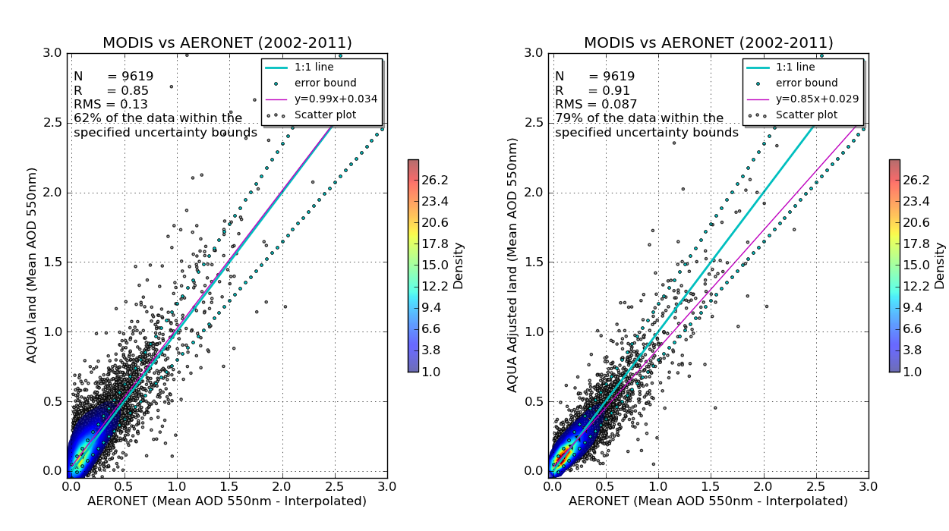
Neural Net Results: MODIS Aqua Land

Slide 16
Neural Net Results Summary
Dataset / Variable | Compliance – Before | Compliance – After
MODIS Aqua Land | 62 | 79
MODIS Terra Land | 62 | 77
MODIS Aqua Ocean | 58 | 69
MODIS Terra Ocean | 56 | 72
MODIS Aqua Deep Blue | 55 | 61
MODIS Terra Deep Blue | 54 | 63

Slide 17
Neural Network Caveats
NN Tendency to smooth out outliers may not always be desired
Hard to pin down adjustment to a few readily understandable factors, but...
...we can see some of the factors in an exhaustive study of regressor influence by David Lary et al.

Slide 18
Relevant Factors Study
Run full neural network train/test cycle for all 32781 possible combinations
Mutual Information used as proxy for effectiveness

Slide 19
Bias seems to arise from many small contributions

Slide 20
AeroStat Achievements and Results

Slide 21
Going Forward...

Slide 22
Coming soon...
Summer Internships
Aerostat Mobile Apps, targeting applications
Interactive client-side visualization
Linked scatterplot-map
“Where are these outliers located?”

Slide 23
AeroStat Recap
Comparing aerosol data from different sensors is difficult and time consuming for users
AeroStat provides an easy-to-use collaborative environment for exploring aerosol phenomena using multi-sensor data
The result should be:
More consistency in dealing with multi-sensor aerosol data
Easy sharing of results
With less user effort

Slide 24
Backup Slides

Slide 25
Collaboration Features
Mark (tag) and categorize an interesting feature and/or anomaly in a plot
View marked-up features in plots related to the one currently being viewed
Save bias calculation
Save fusion request settings (tag, comment, share a la Facebook)
Bug report tags
Provide user with list of tags (created by other users) for similar datasets
Ability to re-run workflows from other user tags
Have a "My Contributions" option, where user can click on previously tagged items, re-run workflow, view plots)

Slide 26
Percent of Biased Data in MODIS Aerosols Over Land Increase as Confidence Flag Decreases
*Compliant data are within + 0.05 + 0.2τ_{Aeronet}
Statistics from Hyer, E., J. Reid, and J. Zhang, 2010, An over-land aerosol optical depth data set for data assimilation by filtering, correction, and aggregation of MODIS Collection 5 optical depth retrievals, Atmos. Meas. Tech. Discuss., 3, 4091–4167.

