Slide 1


Monitoring Riparian Buffer Zones along the
Tar River Basin using EOS Land Products
Jennith Thomas, Terence Goard, Shakeila Jones, and Ryan Wegener Louisburg College, NC (USA)
Derek Halberg
Tar River Land Conservancy, NC (USA)
Lucy McFadden and Miguel O. Román
NASA Goddard Space Flight Center, MD (USA)
SUPPORT:
NASA-GSFC Office of Higher Education (600)
GSFC Terrestrial Information Systems Branch (614.5)
NASA-CIPAIR program (Grant #NNX10AU70G)
Tar River Land Conservancy

Slide 2
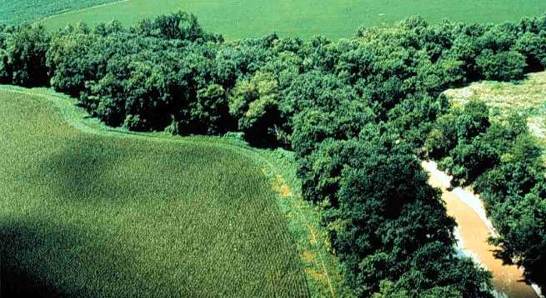
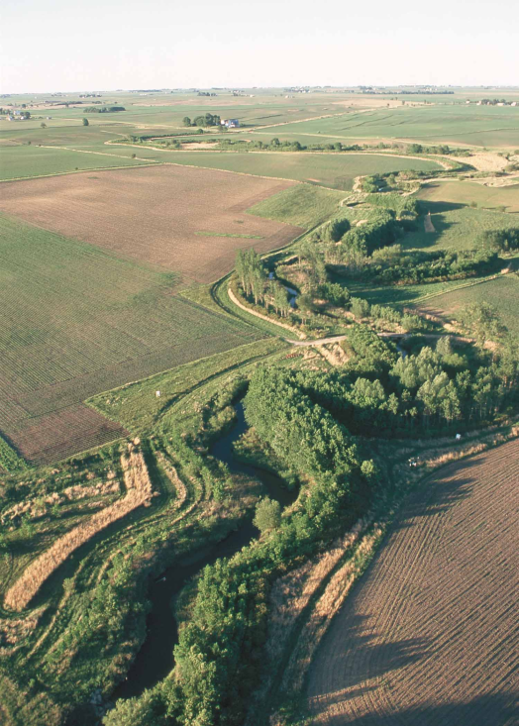
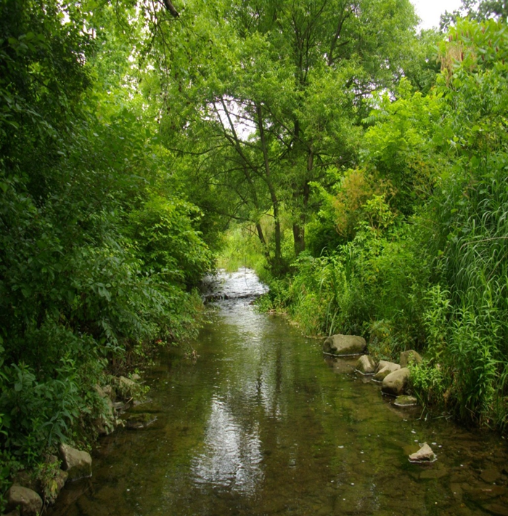
Overview
- Riparian buffer zones are vital to the ecological and biological health of watershed ecosystems.
- This project focused on a region (26,000 km²) of North Carolina, USA, including the Tar River.
Remote Sensing and GIS Tools
MODIS Land Biophysical Products
LEDAPS 30m Surface Reflectance
NC Division of Water Quality GIS Data
Notes:
Upper Tar River watershed: one of the most important watersheds on the Eastern US coast because it is home to a number of endangered species, some of which are found nowhere else on Earth.
Riparian buffer zone: a narrow strip of vegetation that follows the contours of the river, buffering it from agriculture or logging and protecting the wildlife that live in or near it.

Slide 3


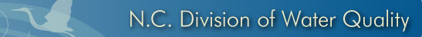


Data Ingestion, Processing, and Analysis
Notes:
Acquired MODIS Collection 5 LST, LAI, and GPP over the Upper Tar River study area using subsets obtained from the Oak Ridge National Laboratory Distributed Active Archive Center (ORNL DAAC).
Created 30m change detection composites from surface reflectance datasets obtained using the Landsat Ecosystem Disturbance Adaptive Processing System (LEDAPS).
Finally, we used ENVI and ArcGIS software, to combine the satellite datasets with the North Carolina streams GIS Layer to monitor changes in the riparian buffer zone over a 10 year period (2000-2010).

Slide 4



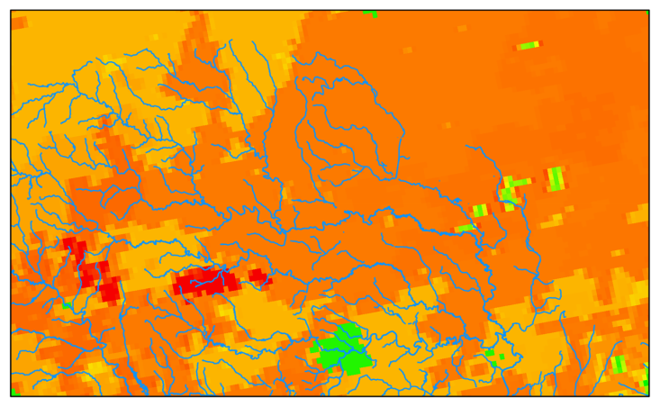
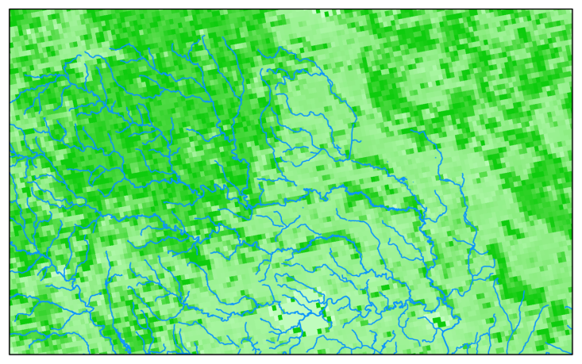
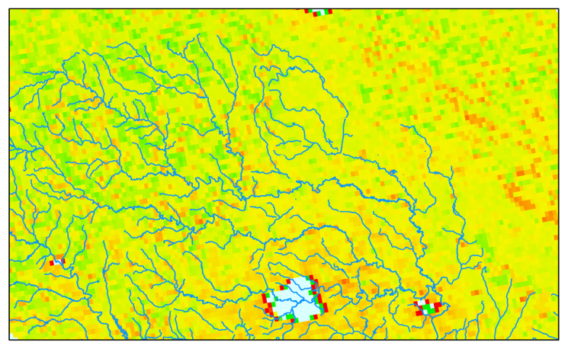
Upper Tar River Basin
LST is sensitive to vegetation and soil moisture; hence it can be used to detect land use/land cover changes.
LAI is used to calculate evapotranspiration and eventually affects water characteristics (e.g., stream volume, flow, and quality).
GPP: measures organic compounds produced by plants from ambient carbon dioxide.

Slide 5
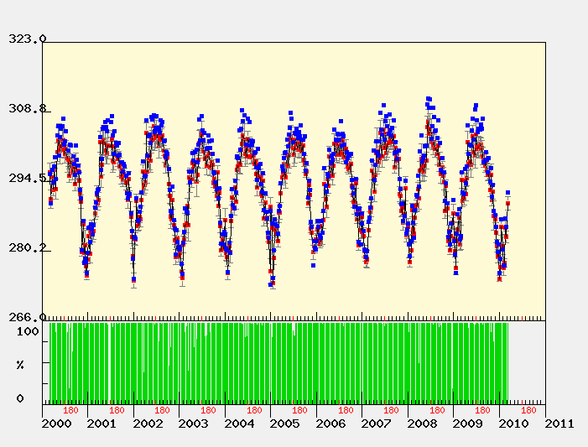
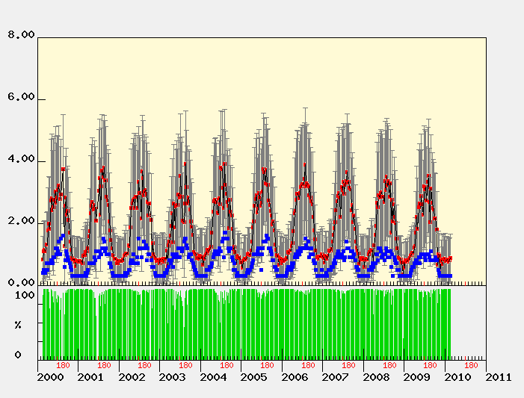
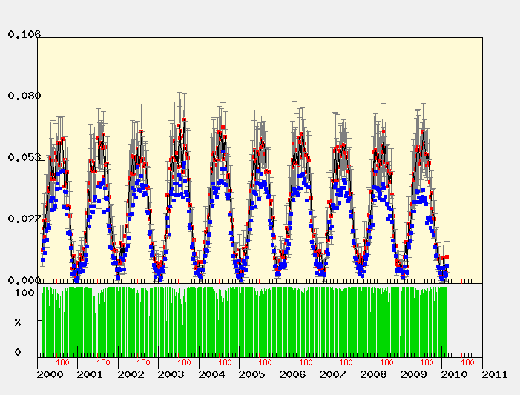


10yr MODIS Time Series over Tar River Basin
LST
LAI
GPP
Notes:
(A.) Aggregate of LST for March 5, 2000 and March 6, 2010. Blue dots show MODIS LST retrievals measured at the exact center of the study area, which happens to be positioned on US Highway 64, NC
. It is easy to see that temperatures measured on a roadway tend to be hotter in the summer and colder in the winter than temperatures measured in areas of vegetation.
(B.) MODIS LAI retrievals collected during Feb 18, 2000 to Feb 18, 2010. Each pixel represents vegetation for a scale (0 to 6). A seasonal variation can be detected in the data, due to the seasons and growth for croplands and natural vegetation.
(C.) MOD17A2 Collection 5.1 GPP MODIS DATA dating from day of year 049-2000 until 049-2010. Seasonal variations show a strong correlation between net photosynthesis and its direct impact on GPP.

Slide 6
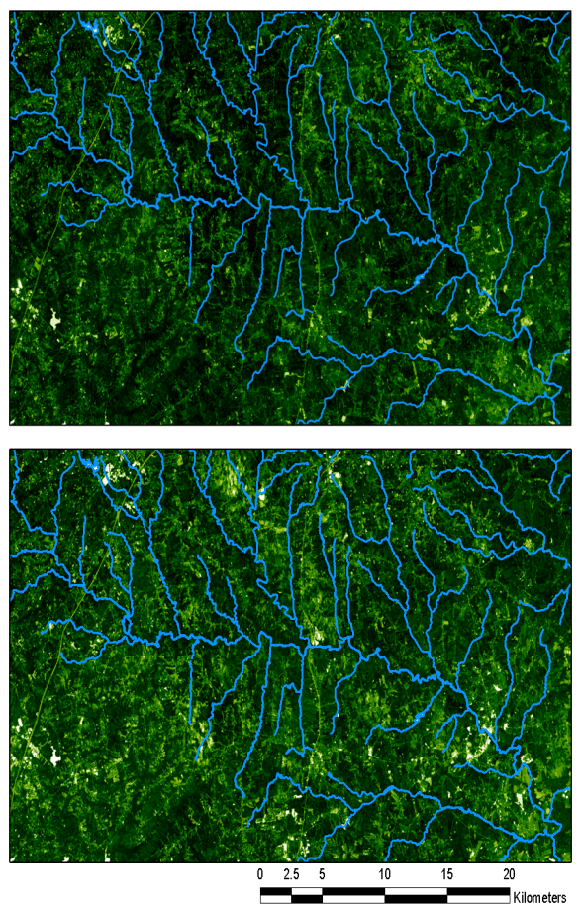
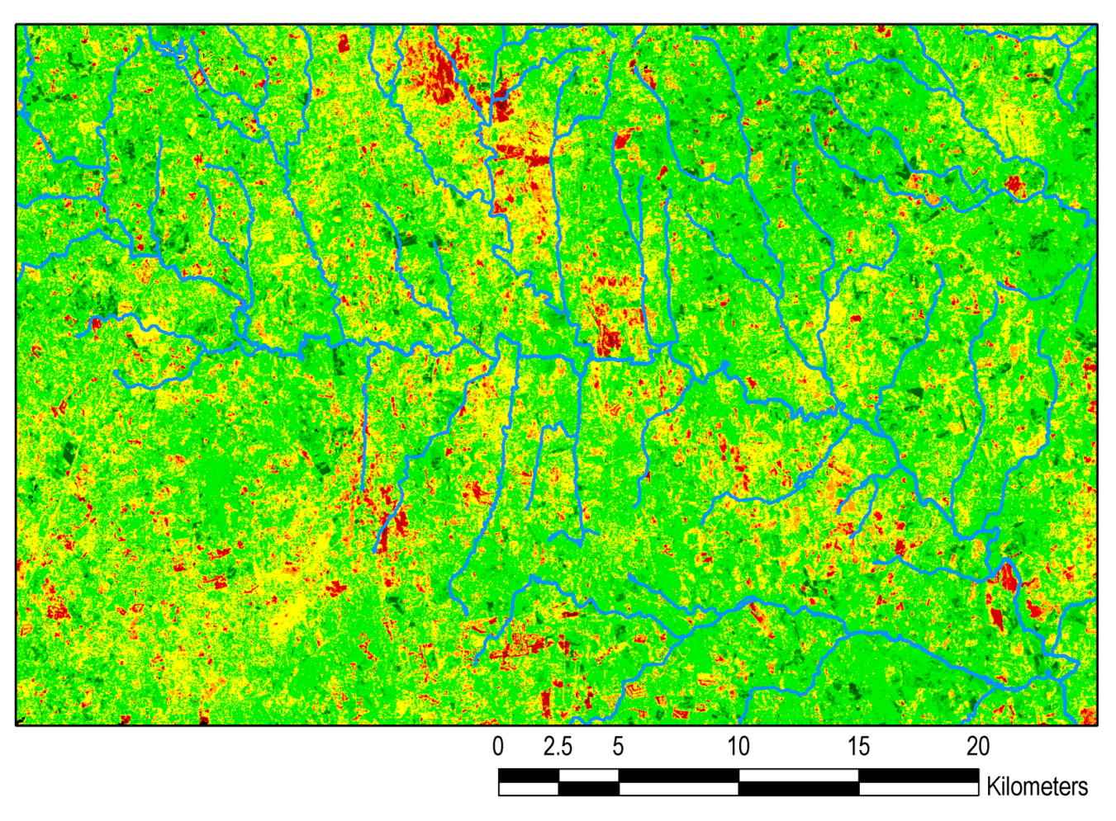
Change-Detection Analysis using LEDAPS NDVI
08/1999
08/2008
R/O = Disturbed Y = Stable or No Change G = Regenerated
Notes:
(A and B) Before and after NDVI composites retrieved on August 1999 and 2008 over the Upper Tar River basin. (C) Change detection image showing the overall change in NDVI for the 1999-2008 period.
NDVI measures the amount of greenness of a target area associated with photosynthetically active vegetation. It can be derived from surface reflectance data (e.g., LEDAPS). NDVI can be used to monitor seasonal and interannual changes (e.g., vegetation phenology) and is a good indicator of surface disturbance (e.g., deforestation, and droughts).

Slide 7

RELEVANCE TO NASA:
- NASA’s Strategic Mission Goal #2: “To expand scientific understanding of the Earth and the universe in which we live.”
- NASA’s Strategic Mission Goal #6: “To share NASA with the public, educators, and students to provide opportunities to participate in our mission, foster innovation and contribute to a strong National economy.”
SCIENTIFIC SIGNIFICANCE:
Citizens of North Carolina will receive new information and analysis insights into the ecological functioning and biodiversity of the Upper Tar River watershed.

Slide 8
SUMMARY
We have established a framework of information for the upper Tar River Basin using EOS Land Products and GIS data.
We have determined the best way to capture the spatial (30m) and temporal scales (~2-5 years) of disturbed riparian communities.
We plan to do field work, particularly validation, in support of land biophysical products retrieved from VIIRS and Landsat/LDCM.
Using ENVI and ArcGIS Spatial Analyst, we will generate buffer zones around protected areas to develop a capability that provides automated disturbance detection and monitoring of riparian forest buffers may be accomplished from satellite observations.

